Slide 1


Kadir Has University
Directorate of Student Affairs
SPARKS and Course Registration Process

Slide 2
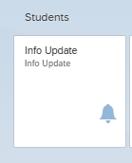
REGISTRATION PROCESS
https://kayit.khas.edu.tr/
Log in to the Sparks system with the user name and password you have received via e-mail.
Before doing course registration, students need to complete their registration by filling out the ‘Student Information Form’ and create a personal e-mail account. To reach ‘Student Information Form’ click the ‘Info Update’ on your Sparks page.

Slide 3
Password update
https://password.khas.edu.tr/
For any other issues with your student account you may contact IT department via bt-destek@khas.edu.tr

Slide 4
https://sparks.khas.edu.tr/
SPARKS
(student PORTAL)
Students can complete the following operations regarding the course registration on SPARKS.
Course Registration
Prebooked / Booked Courses
Course Withdrawal
Re-registration

Slide 5
https://sparks.khas.edu.tr/
SPARKS
(student PORTAL)
Frequently Used Student Apps
Offered Courses
Document Request
Grading and Personal Information
Course Schedule

Slide 6
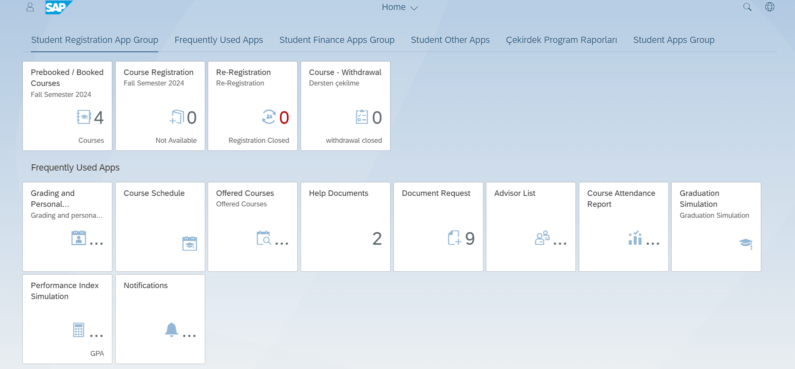
https://sparks.khas.edu.tr/

Slide 7
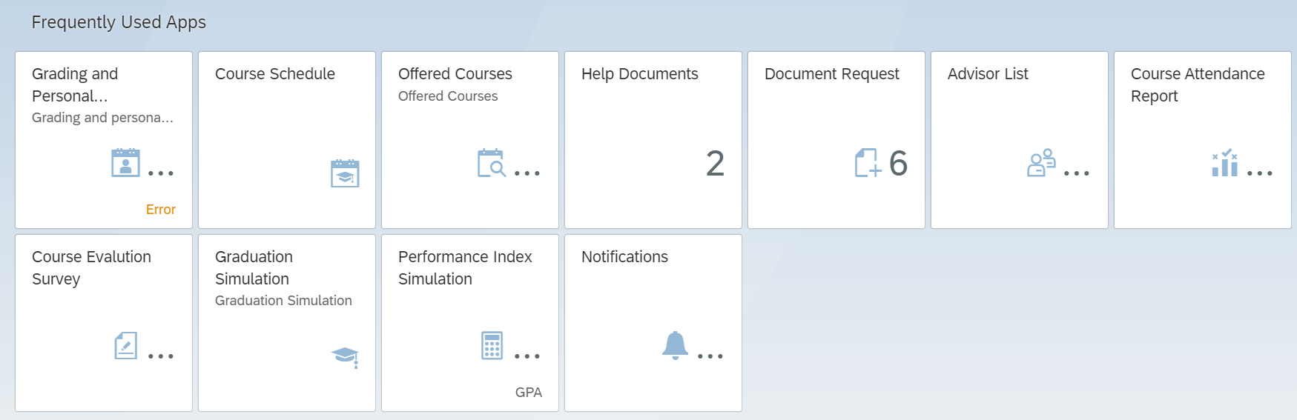
https://sparks.khas.edu.tr/
DOCUMENT REQUEST
sparks.khas.edu.tr or belge@khas.edu.tr
Aslıhan ÖZEL
Ext No: 1158 aslihan.ozel@khas.edu.tr

Slide 8
Academıc ADVISOR
Academic advisors are assigned to students for the semester.
Please consult your advisor before starting your course registration process.

Slide 9
Academıc ADVISOR
https://sparks.khas.edu.tr/

Slide 10
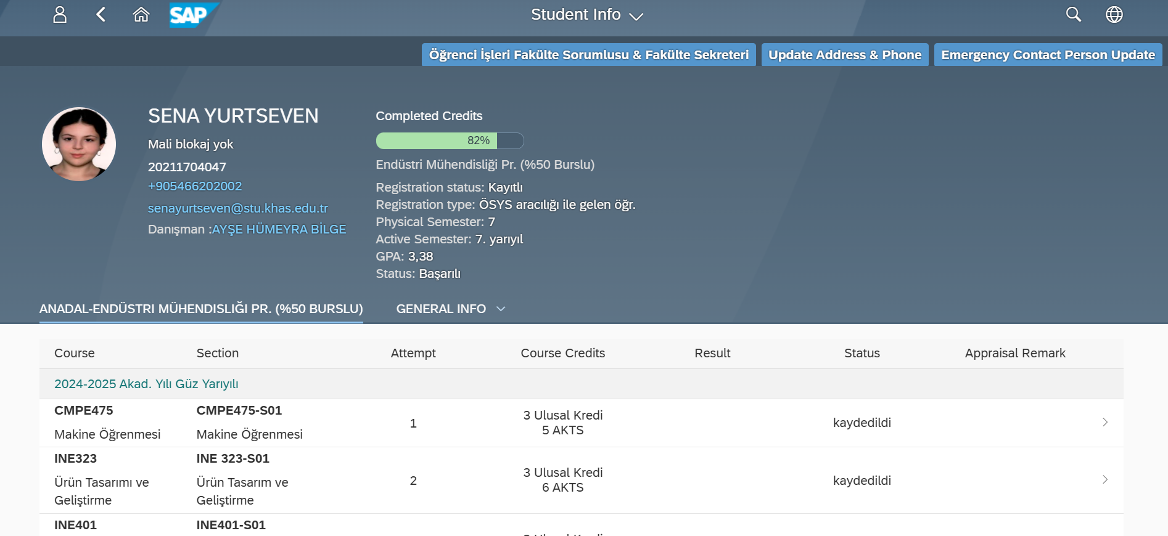
Academıc ADVISOR
https://sparks.khas.edu.tr/

Slide 11
https://sparks.khas.edu.tr/
SPARKS – Course regıstratıon process
Students select the courses.
The selected courses are added to the registration cart.
The courses in the registration cart are sent to the advisor for approval.
The courses which are not sent to the approval are removed from the registration cart on the same day at 23.59.
If the advisor approves the courses
All the courses are approved.
If the student has enough credit, he/she can select an additional course and send it to approval.
If a change is requested for approved courses, advisor’s approval can be retrieved. The courses drop to the registration cart.
If the advisor rejects the courses
The rejected courses drop to the registration cart.
The courses in the registration cart can be rearranged and sent back to approval.
The courses which are not sent to approval are removed from the registration cart the following day at 23.59.

Slide 12
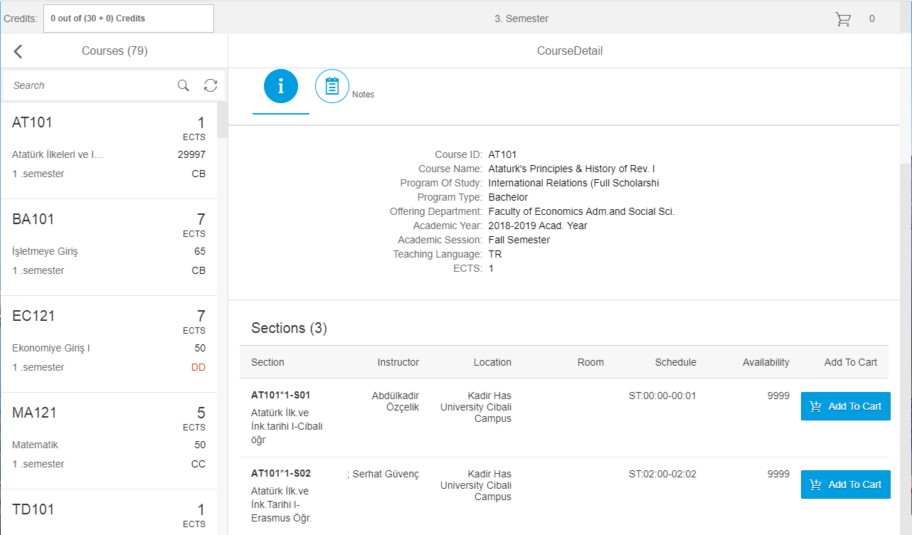
https://sparks.khas.edu.tr/

Slide 13
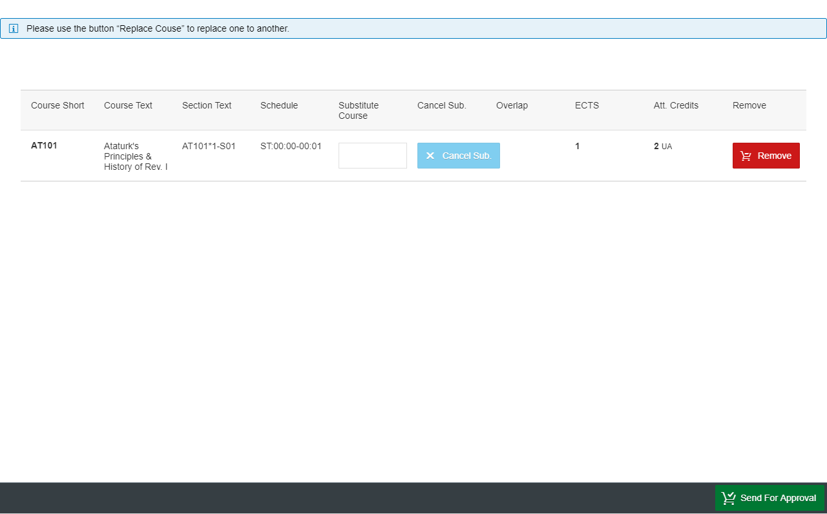
https://sparks.khas.edu.tr/

Slide 14
https://sparks.khas.edu.tr/
SPARKS – COURSE ADD/DROP PERIOD
Students can make add/drop transactions up to the amount of their semester credit.
The courses to be added/dropped are added to the registration cart.
The courses are sent to the advisor for approval.
The courses which are not sent to the approval are removed from the registration cart on the same day at 23.59.
If the advisor approves the courses
The courses to be added/dropped are approved.
The student can continue to add or drop courses if he/she wishes.
If the advisor rejects the courses
The courses which are not approved drop to the registration cart.
The courses in the registration cart can be rearranged and sent back to approval. The courses which are not sent to approval are removed from the registration cart the following day at 23.59.

Slide 15
Thıngs to know about course regıstratıon process
When the student’s courses are at advisor’s approval, they can continue to add courses to the registration cart and send them for approval.
Double check if your courses are approved or not.

Slide 16
COURSE QUOTAS
If there is an issue regarding the course quotas, please contact Faculty Secretariat.

Slide 17
Thıngs to know about regıstratıon cart
Students can add up to 15 courses to the registration cart.
Students can check whether the courses in the registration cart overlap.

Slide 18
https://learn.khas.edu.tr/
KHAS LEARN
KHAS Learn enables instructors to communicate with their students, share course materials, organize activities such as homework/projects outside of the classroom.
For any questions or issues, you may send an e-mail to learn@khas.edu.tr

Slide 19
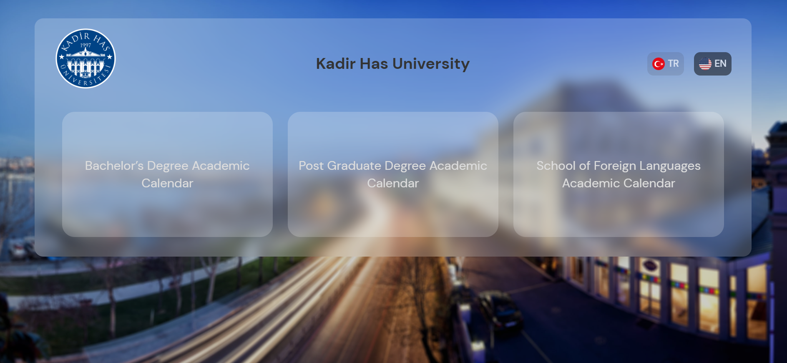
Academıc calender
https://akademiktakvim.khas.edu.tr/

Slide 20
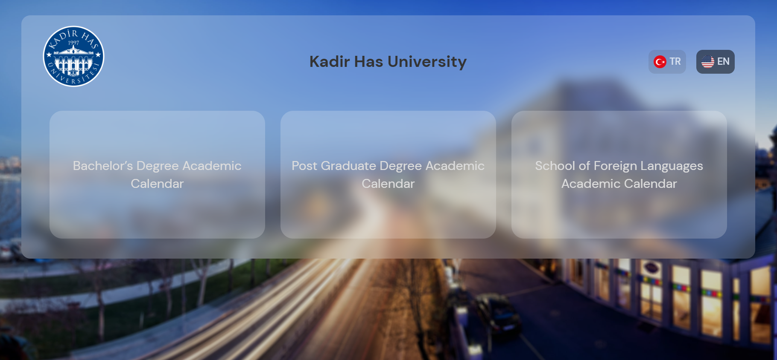
School of graduate studıes
https://sgs.khas.edu.tr/en/
https://akademiktakvim.khas.edu.tr/
For more information, please send an e-mail to sgs@khas.edu.tr

Slide 21
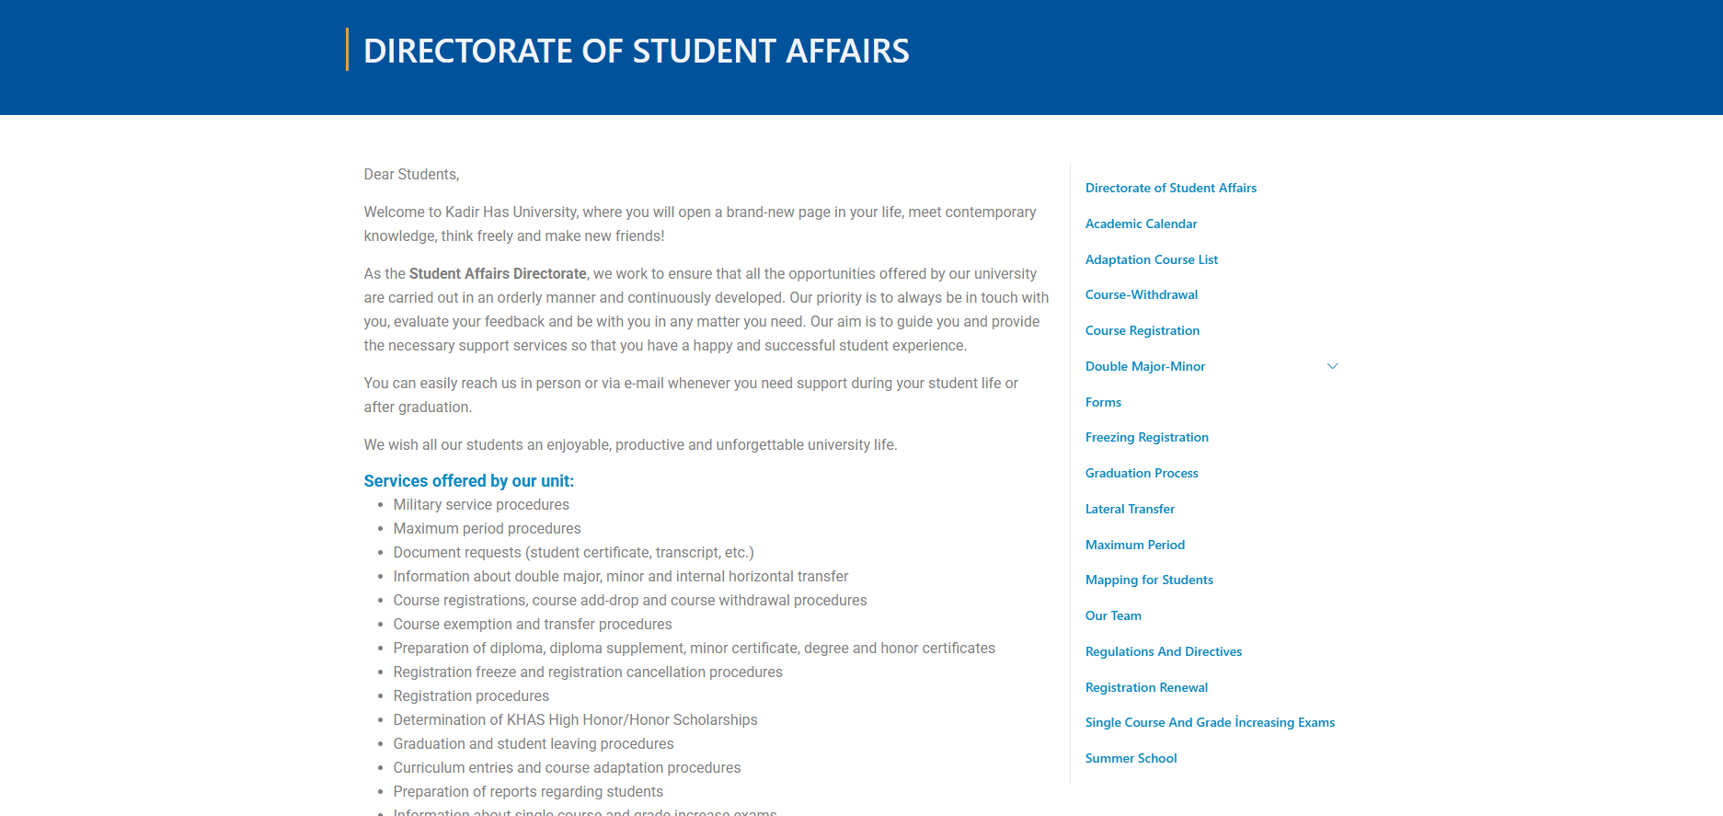
https://www.khas.edu.tr/en/directorate-of-student-affairs/

Slide 22
announcements
Please follow announcements on;
www.khas.edu.tr
MyKHAS Portal (stu-my.khas.edu.tr)

Slide 23
Please do not hesitate to contact us if you have any questions.
Ext. No: 1156, liyana.erkan@khas.edu.tr
WE WISH YOU SUCCESS IN YOUR UNIVERSITY LIFE
THANK YOU

